Slide 1
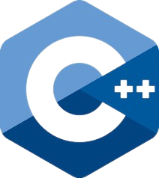
CapacityBay C++ COURSE DANIEL EMEKA - ILOZOR

Slide 2
#4 OPERATORS AND ERRORS

Slide 3
TABLE of contents
Operators
Operator Precedence
Translating formulas to Code
Minimizing errors and comments

Slide 4
01 OPERATORS

Slide 5
Operators
Operators in C++ are symbols that perform specific operations on variables or values. They are the fundamental building blocks of any programming language. C++ supports a wide variety of operators that can be categorized into the following types:
Arithmetic Operators Relational Operators Logical Operators Assignment Operators Bitwise Operators Pre/Post-fix Operators

Slide 6
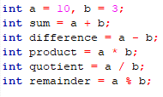
Arithmetic Operators
Arithmetic operators are used for performing basic arithmetic operations such as addition, subtraction, multiplication, division, and modulus (remainder). You are already familiar with most of them…

Slide 7
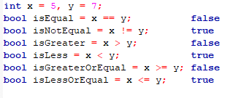
Relational Operators
Relational operators are used to compare two values and evaluate to a boolean result (true or false).

Slide 8

Logical Operators
Logical operators are used to combine multiple conditions and evaluate to a boolean result.

Slide 9

ASSIGNMENT Operators
Assignment operators are used to assign values to variables.

Slide 10
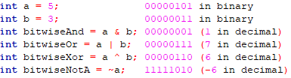
BITWISE Operators
Bitwise operators are used for manipulating individual bits of a variable.

Slide 11

Pre/Postfix Operators
In C++, the increment (++) and decrement (--) operators can be used in two different ways: pre-increment/decrement and post-increment/decrement. The prefix operators do exactly the same thing as the postfix operators at a glance, but there is a subtle difference…

Slide 12

Pre-increment/Decrement
The pre-increment and pre-decrement operators increment or decrement the value of the variable before its value is used in the expression.

Slide 13

POST-increment/Decrement
The post-increment and post-decrement operators increment or decrement the value of the variable AFTER its current value is used in the expression.
It is important to remember the difference,
prefix = before, postfix = after

Slide 14
02 OPERATOR PRECEDENCE

Slide 15

Operator Precedence
Operator precedence determines the order in which operators are evaluated in an expression. C++ follows a specific hierarchy for operators, and understanding this precedence is crucial to avoid unexpected results.

Slide 16
Operator Precedence
Each operator has a “level” of precedence. I.e. the higher the level, the more important the operator is. A more important operator will be processed before other operators of lower importance. When it comes to operators with equal level of precedence, C++ performs the calculation in a left->right fashion. I.e. the one that appears earlier when reading the equation from left to right is the one that is calculated first.

Slide 17
Operator Precedence
Operators
()
+ - (unary)
++ --
! ~
* / %
+ - (binary)
< <= > >=
== !=
&
^
|
&&
||
= += -= *= /= %= &= ^= |=
Operator Precedence

Slide 18
03 TRANSLATING FORMULAS TO CODE

Slide 19
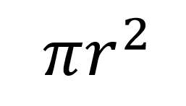
Understand the Formula
Translating mathematical formulas to C++ code is essential for solving computational problems.
The first step in doing this is to understand the formula.
Fully comprehend the mathematical formula you want to translate.
Identify variables and mathematical operations involved.
Consider any constants or predefined values present in the formula.

Slide 20
Declare Variables
Create C++ variables corresponding to the formula variables.
Use appropriate data types (e.g., int, double) for each variable.
Optionally, prompt the user to input values for the variables.

Slide 21

Input Values (Optional)
If required, use cin statements to obtain user-provided data. Example:

Slide 22

Translating the Formula
Use C++ arithmetic operators to replicate the mathematical operations.
Replace each operation with the corresponding C++ operator.
Use parentheses to group operations and maintain the order of evaluation.
Incorporate predefined constants as necessary.
Example:

Slide 23
OUTPUT AND VERIFY
Output the result with cout and format the output as needed.
Thoroughly test your C++ code with different inputs, including edge cases.
Verify results against manual calculations.
Debug and modify the code as needed.

Slide 24
04 errors

Slide 25

ERRORS
Errors are an inevitable part of programming, and understanding their nature is essential for becoming a proficient C++ programmer. Errors in C++ can be broadly classified into three types:
Syntax errors
Compilation errors
Logic errors

Slide 26
SYNTAX ERRORS
Syntax errors occur when the code violates the rules of the programming language. These errors are detected by the compiler during the compilation process and prevent the code from running.
Examples of syntax errors:
Missing semicolons at the end of statements.
Mismatched parentheses or brackets.
Misspelled keywords or variable names.
Minimizing syntax errors is just a matter of learning more about the rules of a language and getting used to the debug messages.

Slide 27
COMPILATION ERRORS
Compilation errors occur when the code fails to compile due to issues like undeclared variables, missing header files, or incorrect function signatures.
To minimize compilation errors:
Pay attention to compiler messages and read them carefully to identify the location and type of the error.
Ensure that all variables and functions are declared before use.
Include the necessary header files for functions or libraries used in your code.

Slide 28
LOGIC ERRORS
Logic errors happen when the code compiles and runs but does not produce the expected output due to flawed logic. These errors can be challenging to detect because the code runs without any error messages. Hence, it is crucial to make sure you do not have any logic errors because they can take up a lot of time to find in many cases(if you ever find them).
To minimize logic errors:
Carefully plan your code and understand the problem requirements.
Use debugging techniques, such as print statements or a debugger, to trace the flow of your program and identify issues.
Run test cases with different inputs to verify the correctness of your code.

Slide 29
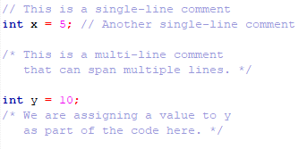
COMMENTS
Comments are essential for adding explanations or notes to the code, making it more readable and maintainable.
In C++, you can use two types of comments:
Single-line comments
They start with // and extend to the end of the line.
Multi-line comments
Multi-line comments begin with /* and end with */. They can span multiple lines and are used when commenting on larger blocks of code.

Slide 30
THANKS Q/A

